Slide 1
Object Recognition Using Neural Networks
Finally, a use for all those cat videos
Presenter: Edward Preble
DOG
CAT

Slide 2
Intro
Edward Preble, Data Scientist at RTI International
NCSU Institute for Advanced Analytics Class of 2017
Background:
Degrees in science and engineering (nuclear eng., materials science)
Worked in semiconductor industry for 15 years
All slides and code on my github page: https://github.com/epreble/
Intro

Slide 3
Neural networks are sooooo complicated…. do I REALLY need to care???
YES

Slide 4
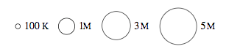
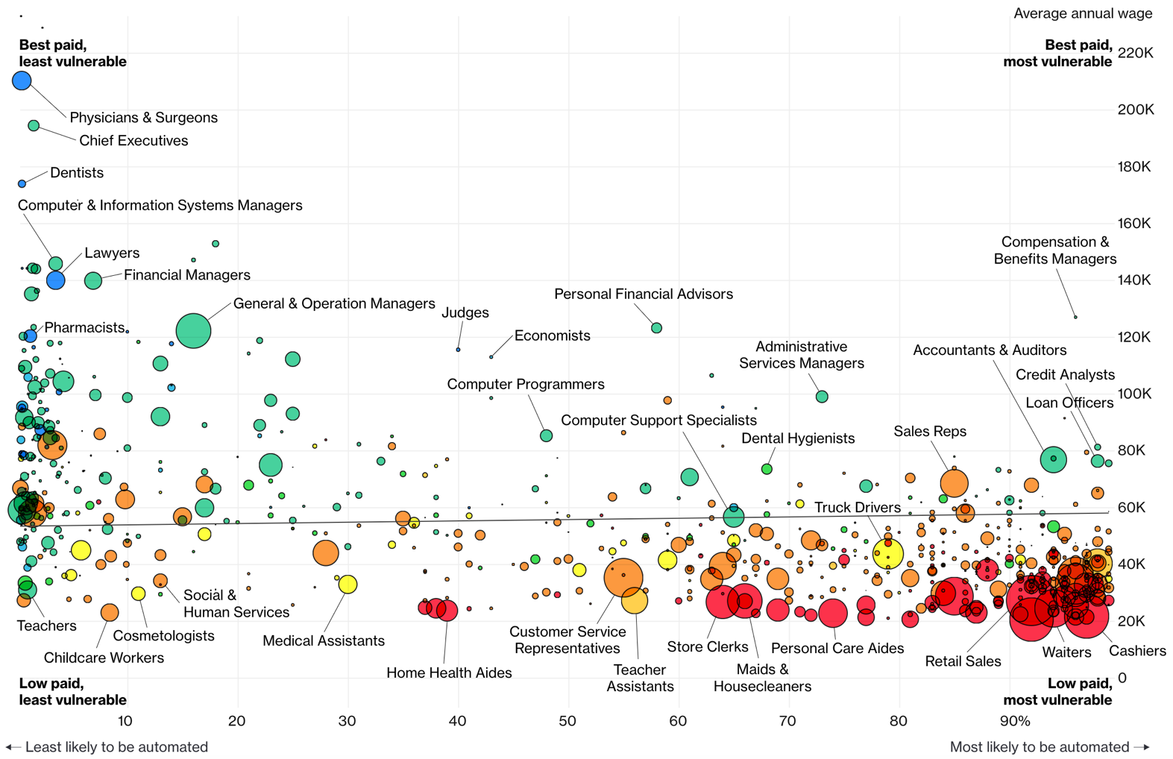
Jobs likely to be displaced by automation (esp. Neural Networks)
Bloomberg 7/2017

Slide 5
How are CNN’s going to automate jobs?
CNN’s are enabling a big leap for sensory data processing (auditory, visual, IoT sensors)
Image Recognition Accuracy
95-98% accuracy is a typical benchmark to outperform humans
Intro

Slide 6
Agenda
Choose your adventure
Theory Focus – Inside CNNs
-OR-
Application Focus – Demo’s
How Neural Networks Work
Tensorflow Playground Demo
(Not too mathy)
Backpropagation
Transfer Learning
Transfer Learning
Face Recognition Demo
Live-train a model to recognize
3 students
Applications
Intro

Slide 7
Agenda
Choose your adventure
Theory Focus – Inside CNNs
-OR-
Application Focus – Demo’s
How Neural Networks Work
Tensorflow Playground Demo
(Not too mathy)
Backpropagation
Transfer Learning
Transfer Learning
Face Recognition Demo
Live-train a model to recognize
3 students
Applications
Intro
Demo
Back Prop
Transfer
Wrap Up

Slide 8
CNN Diagram for Image Analysis
All Image Pixels
Edges/Curves
Eyes/Nose
Dog
Input Data
Input Layers
Detection Filters
Simple Features
Detection Filters
Complex Features
Classification
Inception v3
(Google CNN Architecture)
Intro
Demo
Back Prop
Transfer
Wrap Up

Slide 9
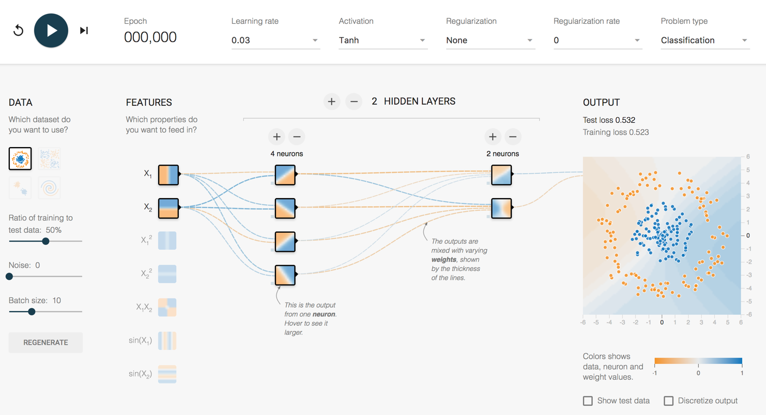
How does it work?
http://playground.tensorflow.org/
Intro
Demo
Back Prop
Transfer
Wrap Up

Slide 10
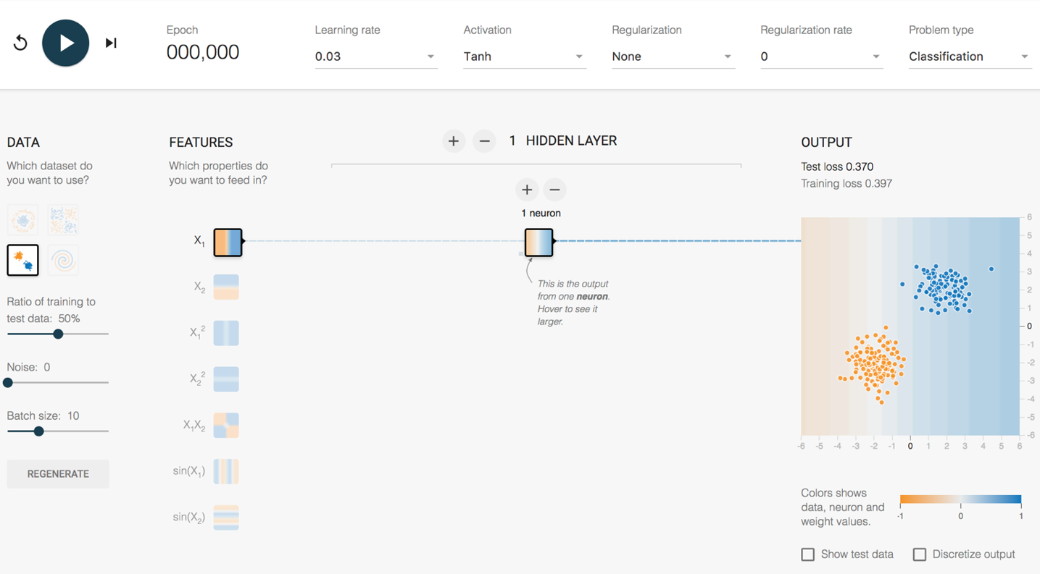
Playground Demo 1
2 Clumps 1 Feature 1 Hidden Layer
1 Neuron
Intro
Demo
Back Prop
Transfer
Wrap Up
Notes:
Maybe this is data from Orange sneakers and Blue sneakers that your boss needs a model for.
Dividing line, left is orange, right is blue.
Look at random initial weights
Single click advance the model on the vertical feature only
Watch weights increase
Division gets clearer
Test loss gets lower and lower
Horizontal feature only
Vertical + horizontal
Show next 3 features that they don’t work
This is a fundamental problem of SHALLOW NETWORKS. Bad feature = Bad results.
Do all 5 together
Weights that increase are said to be ACTIVATED

Slide 11
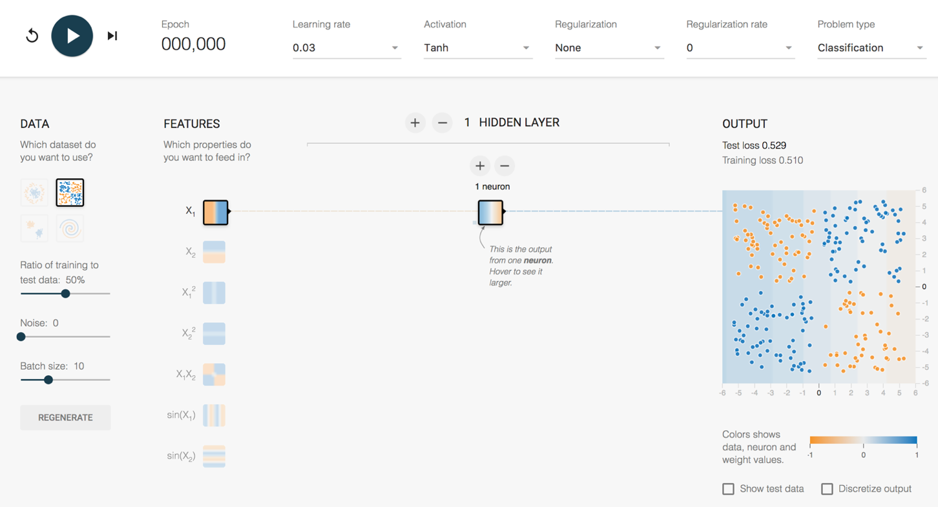
Playground Demo 2
4 Clumps 1 Feature 1 Hidden Layer
1 Neuron
Intro
Demo
Back Prop
Transfer
Wrap Up
Notes:
Your boss is super excited. She says your sneaker model is awesome, so lets also use it on our data from orange and blue basketball shoes.
Lets take the same model and “TRANSFER” this model to new data.
1 feature, 1 layer, 1 neuron – terrible
2 feature, 1 layer, 1 neuron – now get an angle, better
2 feature, 2 layer, 1/1 neuron – Makes no sense to have single neuron into single neuron, can reverse info, but can’t adjust it
2 feature, 2 layer, 2/1 neuron – Sometimes single line, like above. Sometimes more of a “corner”, sometimes makes a valley (best)
Layer 2 convolves layer 1
Hover over neurons and weights for each neuron to show how it adds up
So, with a small network, what is the best way to make this work?
Use the feature that fits the data better – Choose the X1X2 feature

Slide 12
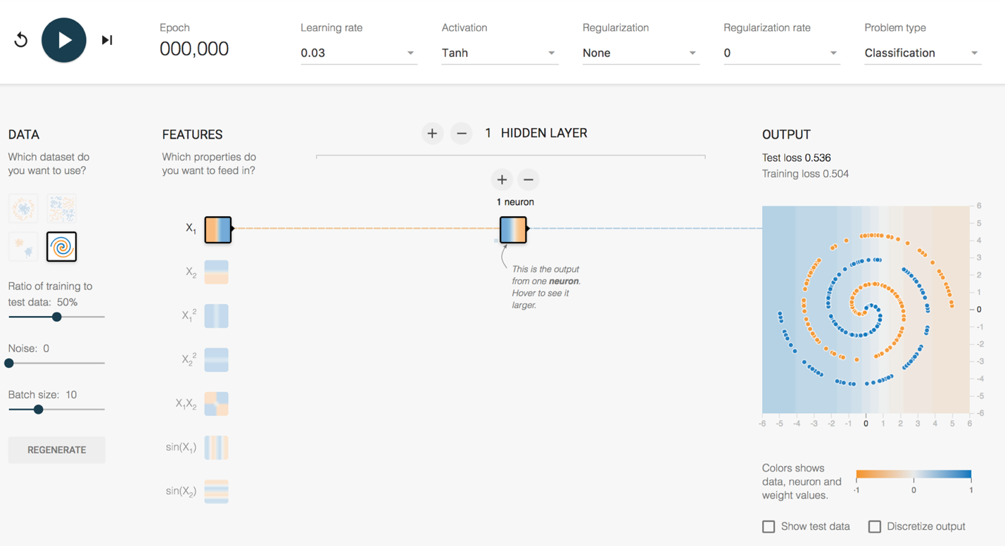
Playground Demo 3
Spiral 1 Feature 1 Hidden Layer
1 Neuron
Intro
Demo
Back Prop
Transfer
Wrap Up
Notes:
So, you’re getting a good reputation with management now. You’ve solved the previously impossible orange and blue basketball shoe problem.
Now, the CEO wants you to solve some horrible manufacturing problem on all the shoes the company makes.
The data looks like this. You don’t even know what you’re looking at.
With small networks of the past, feature engineering was where everyone worked to make this stuff happen. Good features = Good model. Bad features = no luck.
But, what is the magic feature to model a spiral? This is where deep learning is going to come to the rescue.
More complex Shape – Spiral
1 feature, 1 layer, 1 neuron – terrible
All features, - starts making dots
All features , 1 layer, 2 neurons
All features – Keep trying until a partial spiral, not enough complexity to handle full spiral
All features , 5 layers, top layers are washed out. No new information being generated.
All features , 5 layers, 5/4/3/2/1, might get it
6 layers, 7/6/5/4/3/2, starts working pretty well pretty quickly – weird looking, but works
Note simple features on left, complex features on right

Slide 13
Agenda
Choose your adventure
Theory Focus – Inside CNNs
-OR-
Application Focus – Demo’s
How Neural Networks Work
Tensorflow Playground Demo
(Not too mathy)
Backpropagation
Transfer Learning
Transfer Learning
Face Recognition Demo
Live-train a model to recognize
3 students
Applications
Intro
Demo
Back Prop
Transfer
Wrap Up

Slide 14

How does a CNN “Learn”?
Backpropagation
Initial network settings are random
Test it using training data
Adjust network by a certain amount (Learning Rate) to reduce the error
Start at the end of the network and work backwards
?
Dog
Dog
Dog
Dog
Label = Dog
?
Cat
X
Cat
Cat
Cat
?
?
Intro
Demo
Back Prop
Transfer
Wrap Up

Slide 15
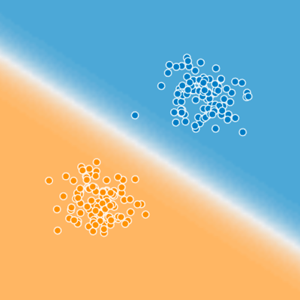

Is that it?
Blue
Cat
Typing
on
Laptop
How to get to here?
Orange
Intro
Demo
Back Prop
Transfer
Wrap Up

Slide 16
Agenda
Choose your adventure
Theory Focus – Inside CNNs
-OR-
Application Focus – Demo’s
How Neural Networks Work
Tensorflow Playground Demo
(Not too mathy)
Backpropagation
Transfer Learning
Transfer Learning
Face Recognition Demo
Live-train a model to recognize
3 students
Applications
Intro
Demo
Back Prop
Transfer
Wrap Up

Slide 17
How complex are these things?
All Image Pixels
Edges/Curves
Eyes/Nose
Dog
Input Data
Input Layers
Detection Filter
Simple Features
Detection Filter
Complex Features
Classification
Inception v3
(Google CNN Architecture)
Number of Parameters = 23,200,000
Number of Layers = 48
Intro
Demo
Back Prop
Transfer
Wrap Up
Notes:
Back to the structure of the CNN, and how these layers start really working for complex images.
For an image, the input layers, instead of being data points like the playground example, they will be the actual pixel values for the image. The last model I used at RTI had 704x704 pixel input images, with 3 colors (RGB), which translates into ~1.5M input neurons.
So, you feed this image into the network, certain neurons and features will “activate”, which will then output at the end, is it blue or orange? Is it a cat or a dog?
On Inception v3, the number of layers is 48, the number of parameters is ~23M, the number of multiply/add calculations per sweep is ~5B.
This is DEEP LEARNING. There is a ton going on under the hood.

Slide 18
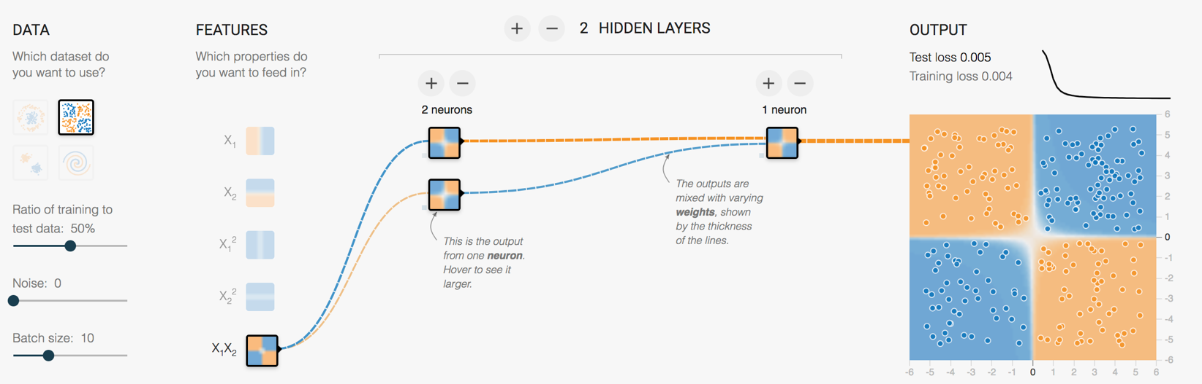
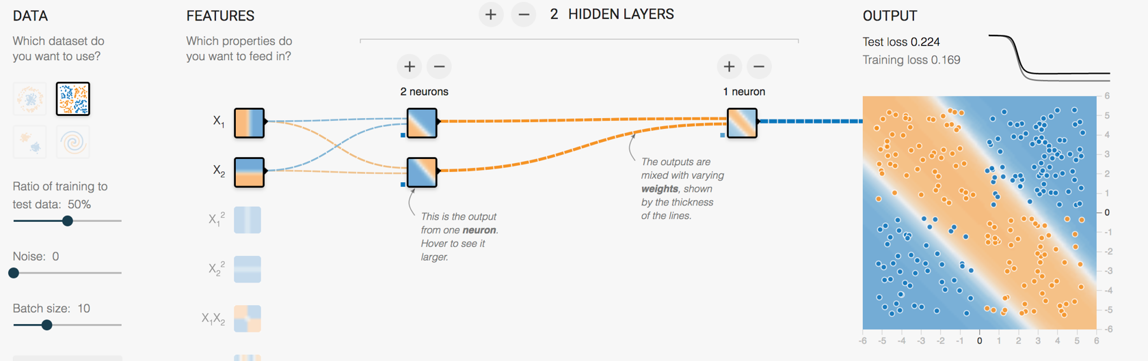
Transfer Learning is a Key Advance
Retraining the last layer is all that is needed for any human recognizable object
ImageNet trained weights for Inception v3 are downloadable
Intro
Demo
Back Prop
Transfer
Wrap Up
Notes:
Remember beginning of lecture, to make the 4 blob data work, we could battle with linear features and a few layer/neuron combos
Or, just needed to use the right feature and it works instantly
Google (and others) have figured out those features and pre-trained a number of model architectures

Slide 19
Where are we today?
Great Google-centric demo→ Tensorflow for Poets
Computational platform → Tensorflow
Model architecture → Inception_v3 structure
ImageNet pre-trained weights
Retraining w/ Python scripts
Intro
Demo
Back Prop
Transfer
Wrap Up

Slide 20
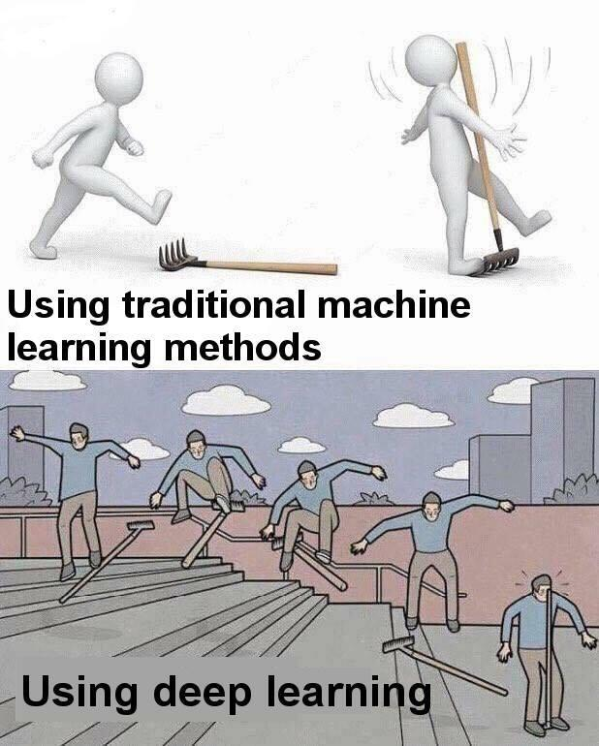
Often, Simple is Better

Slide 21
Resources to Learn More
Entry Level Videos:
Josh Gordon (Google) Machine Learning Tutorials https://www.youtube.com/watch?v=cKxRvEZd3Mw
Siraj Raval - Various Artificial Intelligence Videos https://www.youtube.com/channel/UCWN3xxRkmTPmbKwht9FuE5A
More Advanced
Adrian Rosebrock (Lots of Python and OpenCV Materials) https://www.pyimagesearch.com/
Intro
Demo
Back Prop
Transfer
Wrap Up

Slide 22
Thanks!
Edward Preble Contact Info
Linkedin: https://www.linkedin.com/in/edward-preble/
Github: https://github.com/epreble/
Intro
Demo
Back Prop
Transfer
Wrap Up

